Slide 1
Project #3: Robot Follower

Slide 2
Project Roles
Christian Nickolaou - Vehicle Developer/Computer Vision Developer
Alex Alwardt - Network/Desktop Application Developer
Sean Ramocki - Desktop Application Developer
Eric Ramocki - Desktop Application Developer
Anton Cantoldo - Vehicle Application/Systems Developer
Scott Dudley - Network/Vehicle Systems Developer

Slide 3
Project Plan
Sprint 1
Project Plan, Requirements, Project Scope Capture
Sprint 2
Diagrams, UC: Register Vehicles, Research
Sprint 3
UC: Pilot Drive Lead Vehicle, UC: Follower Vehicle Follows Leader, UC: Collision Detection
Sprint 4
UC: Blocked Follower, UC: Follower Loses Line-of-Sight

Slide 4
Project Plan
Sprint 5
UC: Search Mode
Sprint 6
UC: Return Home Mode
Sprint 7
Dry Run
Sprint 8
Final Competition

Slide 5
Current Sprint
Project Diagram/Documentation
Desktop Application
Registering vehicles I.P. address
Formalized Messaging Protocol
Research Heavy

Slide 6
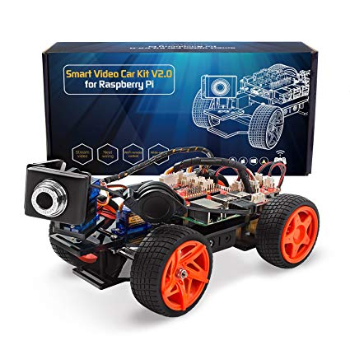
Hardware Setup
2 Raspberry Pis
Using SunFounder Picar-V Kit
Equipped with 2 back wheels controlled for motion
Equipped with 2 front wheels for steering
A USB webcam for image recognition
Desktop Application
Runs a server to manage Raspberry Pis over network, as well as accept user input for leader vehicle.

Slide 7
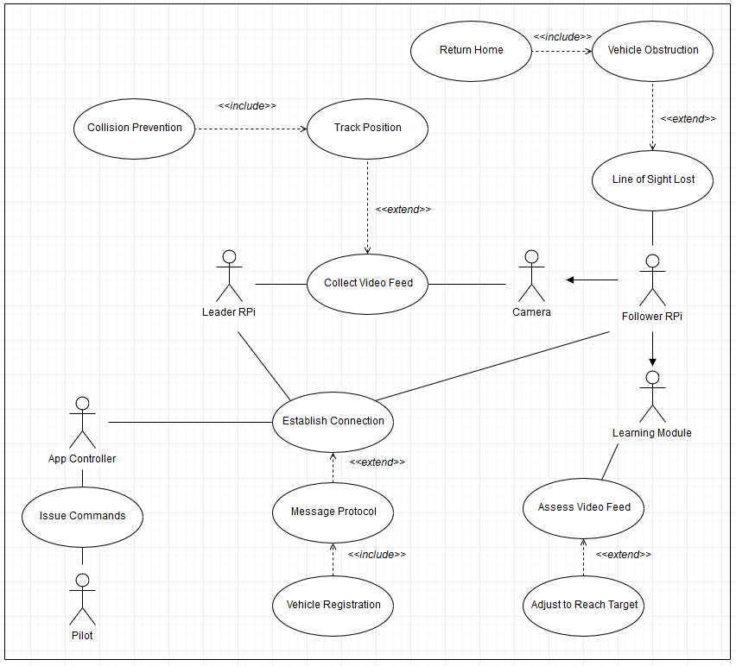
Use Case Diagram

Slide 8
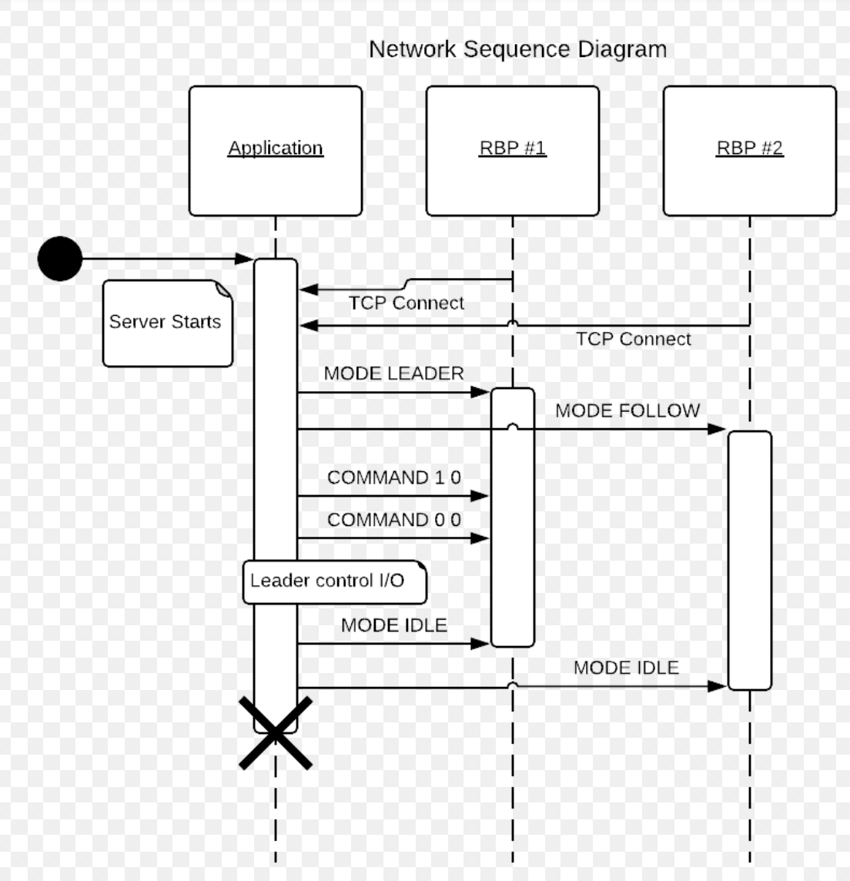
Message Protocol
Application runs a server that Raspberry Pi units connect as clients to.
Messages are sent as ASCII encoded strings via TCP packets.
Message arguments are delimited by spaces.
MODE is followed by the mode to switch to.
COMMAND is followed by 2 floating point numbers to control throttle and steering

Slide 9
Next Sprint Objectives
Implement Message Protocol
Send instructions to the leader vehicle
Register lead vehicle
Get the lead vehicle to follow instructions sent to it
Adapting the command system for the car to our own instructions
Collision Detection System
Using image recognition to determine if a collision will occur

Slide 10
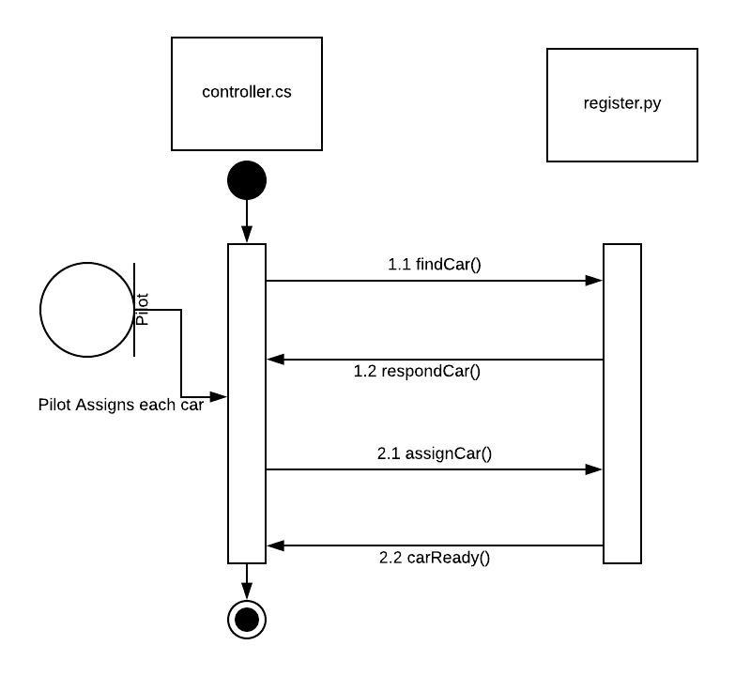
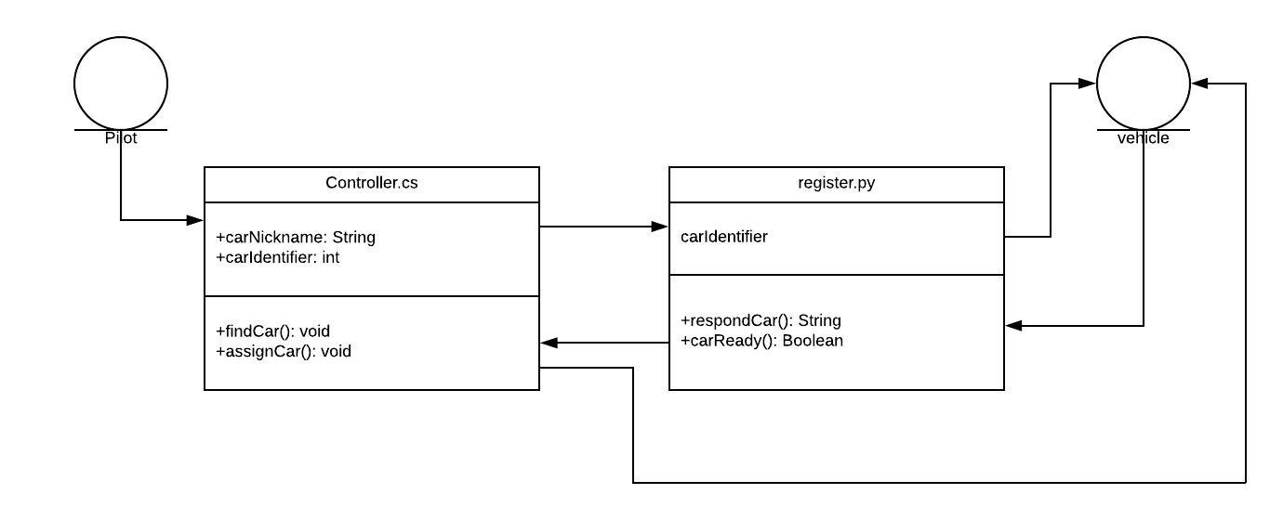
Class & Sequence Diagrams for Upcoming Sprints
Register Lead & Follower Vehicle

Slide 11
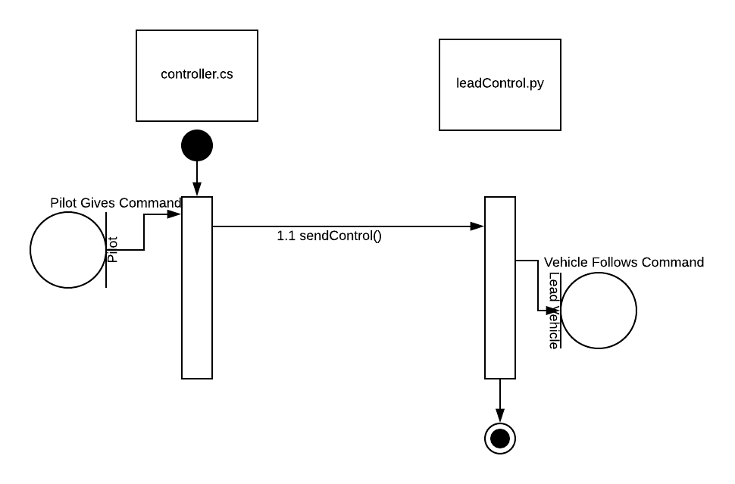
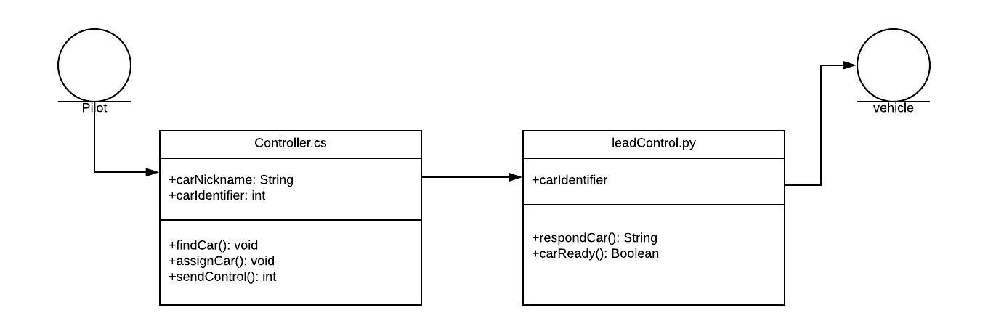
Class & Sequence Diagrams for Upcoming Sprints
Control Lead Vehicle

Slide 12
Risks & Challenges
Communication with TARDEC
Recently decided on vehicle hardware
Currently system is fragmented
Many parts, but not whole
New Material

Slide 13
Mitigation Plan
Buy the components ourselves
Currently own a few Raspberry Pi’s
Limit the scope of the project
Many open-source projects dealing with object tracking
Open Source Software is available

Slide 14
DEMO

